Slide 1
Big Data Frameworks
Ramesh Ragala
VIT Chennai

Slide 2

Hadoop - Introduction
An Open source software framework (Apache Project)
Originally developed by Yahoo (but originated from Google)
Goal:
storage and processing of data-sets at massive scale
Infrastructure:
clusters of commodity hardware
Core Components:
HDFS → distributed file system
Map Reduce → programming model for large scale data processing
Eco Systems
Pig, Hive, Hbase, mahout, zookeeper

Slide 3
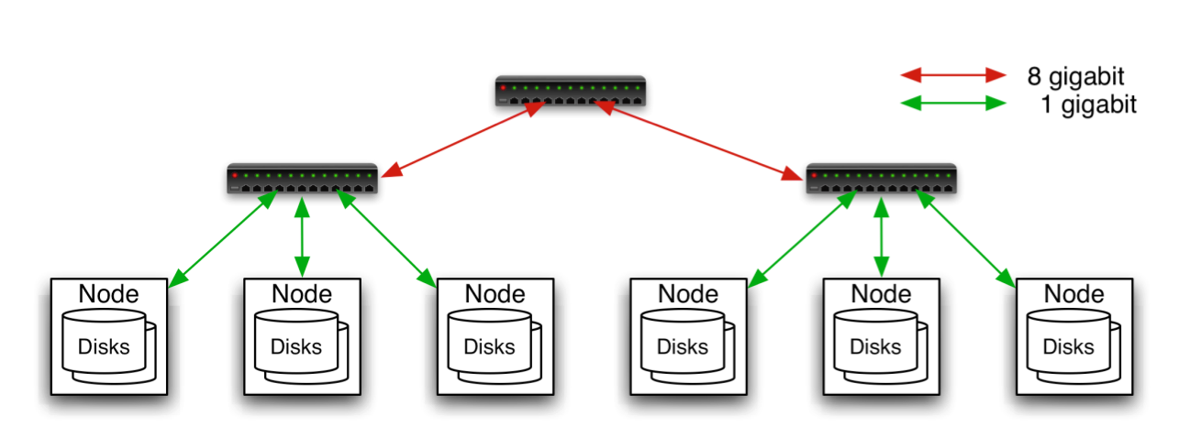
Commodity Hardware
Aggregation switch
Rack switch
Typically in 2 level architecture
Nodes are commodity PCs
30-40 nodes/rack
Uplink from rack is 3-4 gigabit
Rack-internal is 1 gigabit

Slide 4
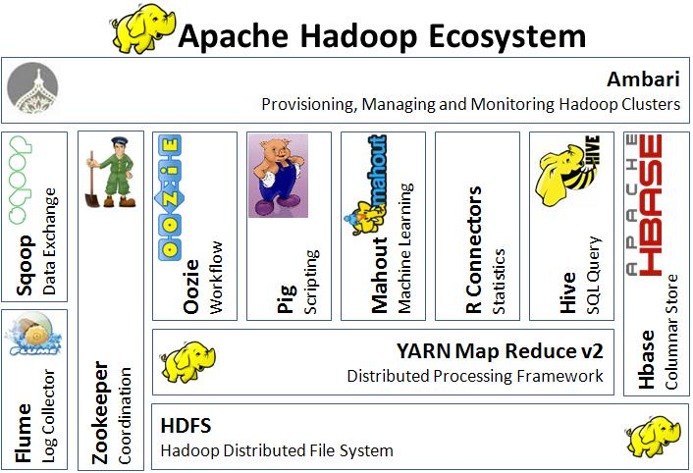
Hadoop - Ecosystem

Slide 5
Hadoop - History
2003: Google publishes about its cluster architecture & distributed file system (GFS)
2004: Google publishes about its MapReduce programming model used on top of GFS
Written in C++
closed-source, Python and Java APIs available to Google programmers only
2006: Apache & Yahoo! → Hadoop & HDFS (Doug Cutting and Mike Cafarella)
open-source, Java implementations of Google MapReduce and GFS
a diverse set of APIs available to public
2008: becomes an independent Apache project
Yahoo! uses Hadoop in production

Slide 6

Hadoop users

Slide 7
What is HDFS
Hadoop Distributed File System
Data is organized into files and directories
Files are divided into uniform sized blocks (default 128MB) and distributed across cluster nodes
HDFS exposes block placement so that computation can be migrated to data
Blocks are replicated (default 3) to handle hardware failure
Replication for performance and fault tolerance (Rack-Aware placement)
HDFS keeps checksums of data for corruption detection and recovery
Good for
Large files
Streaming Data Access
Bad for
Lots of small files
Random Access
Low – Latency Access

Slide 8
What is HDFS
HDFS is a Java-based file system that provides scalable and reliable data storage, and it was designed to span large clusters of commodity servers
HDFS has demonstrated production scalability of up to 200 PB of storage
HDFS has demonstrated a single cluster of 4500 servers, supporting close to a billion files and blocks.
HDFS is a scalable, fault-tolerant, distributed storage system that works closely with a wide variety of concurrent data access applications, coordinated by YARN.

Slide 9
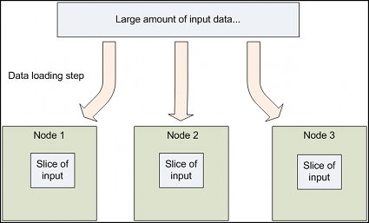
Design of HDFS
GFS like Design
HDFS supports parallel reading and processing of the data
Read, Write, Rename and Append
Optimized for streaming reads/writes of large files
Master – Worker Architecture
Master
Single Name node for managing FS meta
Slaves
Multiple Data Nodes for storing data
One more:
Secondary name node for checkpointing

Slide 10
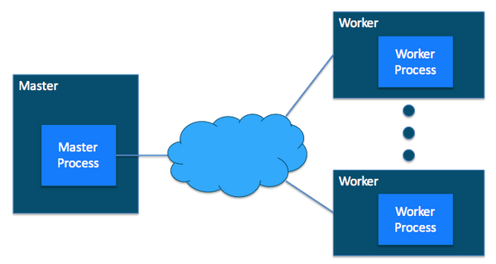
Design of HDFS

Slide 11
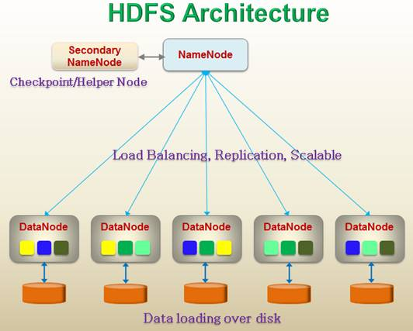
HDFS Architecture

Slide 12
HDFS Master (Name Node)
Manages filesystem namespace tree and holding the entire namespace tree in RAM
Maps a file name to a set of blocks
Maps a block to the DataNodes where it resides
Files and directories are represented by inode
Mapping inode to list of blocks + locations
Authorization & Authentication
Checkpoint & journal namespace changes
Mapping of datanode to list of blocks
Monitor datanode health
Actively monitors the number of replicas of block and
replicate missing blocks
Keeps ALL namespace in memory
It also executes file system operations such as renaming, closing, and opening files and directories.
Cluster Configuration Management
Types of Meta Data:
List of Files
List of Blocks for each files
List of data nodes for each block
File attributes like.. Creation time, replication factor, etc.

Slide 13
HDFS (Data Node)
Handle block storage on multiple volumes & block integrity
Clients access the blocks directly from data nodes
Periodically send heartbeats and block reports to Namenode
Blocks are stored as underlying OS’s files

Slide 14
HDFS
When a replica of a block is lost due to a Datanode failure or disk failure, the namenode creates another replica of block.
The NameNode does not directly send requests to DataNodes.
It sends instructions to the datanodes by replying to heartbeats sent by those datanodes.
The instructions include commands to:
replicate blocks to other nodes,
remove local block replicas,
re-register and send an immediate block report, or
shut down the node.

Slide 15

HDFS Architecture

Slide 16
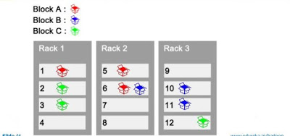
HDFS Replica and Rack Awareness
HDFS follows rack awareness for never loss all the data if entire rack fails.
Rules for Rack Awareness
Need to place the first replica of block in near
available rack
The second replica of block is not placed in
the same rack where the first replica is placed
The third replica should place in where the
second replica is placed but in the different node.

Slide 17
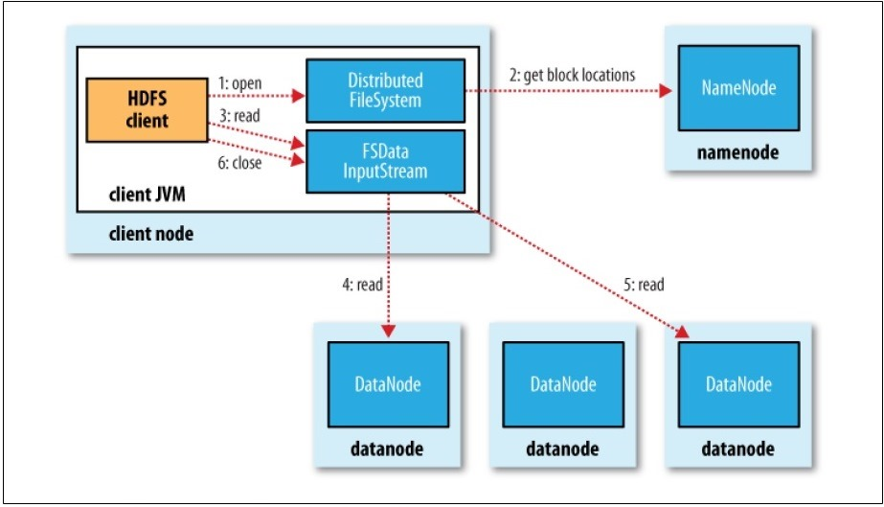
Data Flow: Anatomy of a File Read
To get an idea of how data flows between the client interacting with HDFS, namenode and datanodes

Slide 18
Data Flow: Anatomy of a File Read
The steps for reading data from HDFS:
Step-1: The client opens the file it wishes to read by calling open() on the FileSystem object, which for HDFS is an instance of DistributedFileSystem.
Step-2: DistributedFileSystem calls the namenode, using RPC,
To determine the locations of the blocks for the first few blocks in the file,
For each block, the namenode returns the addresses of the datanodes that have a copy of that block
The datanodes are sorted according to their proximity to the client.
Short-Circuit local reads → if client is its self a datanode
The DistributedFileSystem returns an FSDataInputStream (an input stream that supports file seeks) to the client for it to read data from.
FSDataInputStream in turn wraps a DFSInputStream, which manages the datanode and namenode I/O.
Step-3: The client then calls read() on the stream.

Slide 19
Data Flow: Anatomy of a File Read
The steps for reading data from HDFS:
DFSInputStream, which has stored the datanode addresses for the first few blocks in the file, then connects to the first (closest) datanode for the first block in the file
Data is streamed from the datanode back to the client, which calls read() repeatedly on the stream.
Step-5: When the end of the block is reached, DFSInputStream will close the connection to the datanode, then find the best datanode for the next block
Blocks are read in order with the DFSInputStream opening new connections to datanodes as the client reads through the stream.
Step-6: When the client has finished reading, it calls close() on the FSDataInputStream

Slide 20
Data Flow: Anatomy of a File Read
The steps for reading data from HDFS:
During reading, if the DFSInputStream encounters an error while communicating with a datanode, then it will try the next closest one for that block.
It will also remember datanodes that have failed so that it doesn’t needlessly retry them for later blocks.
The DFSInputStream also verifies checksums for the data transferred to it from the datanode.
If a corrupted block is found, it is reported to the namenode before the DFSInputStream attempts to read a replica of the block from another datanode.
The client contacts datanodes directly to retrive data with the help of namenode

Slide 21
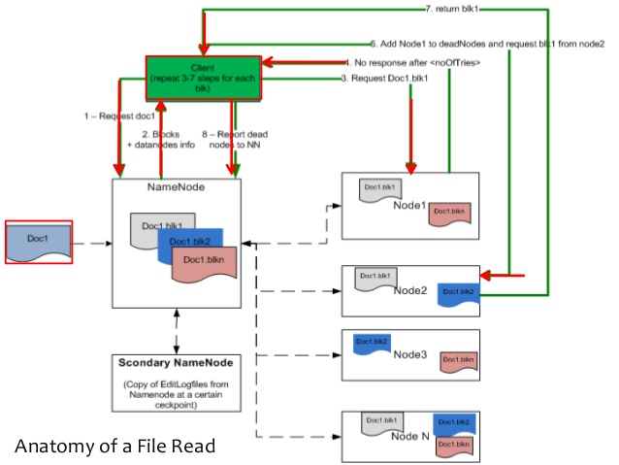
Data Flow: Anatomy of a File Read

Slide 22
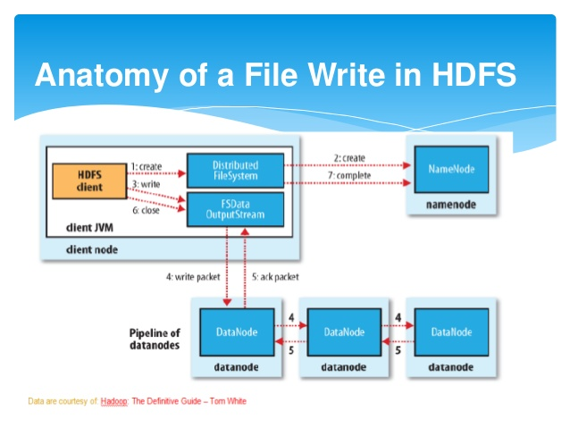
Data Flow: Anatomy of File Write

Slide 23
Data Flow: Anatomy of File Write
To write a file into HDFS, client needs to interact with namenode
Namenode provides the address of the slave on which client will start writing data
As soon as client finishes writing the block, the slave starts copying the block to another slave which in turn copy the block into another slave (default is 3)
After required replicas are created then it will send the acknowledgement to the client
Authentication process is same like file read

Slide 24
Data Flow: Anatomy of File Write
The steps to follows to write a file in HDFS:
Step-1: The client creates the file by calling create() on DistributedFileSystem.
Step-2: DistributedFileSystem makes an RPC call to the namenode to create a new file in the filesystem’s namespace, with # blocks associated with it.
The namenode performs various checks to make sure the file doesn’t already exist, and that the client has the right permissions to create the file
If these checks pass, the namenode makes a record of the new file; otherwise, file creation fails and the client is thrown an IOException.
The DistributedFileSystem returns an FSDataOutputStream for the client to start writing data to.
Step-3: As in the read case, FSDataOutputStream wraps a DFSOutputStream, which handles communication with the datanodes and namenode.
As the client writes data, DFSOutputStream splits it into packets, which it writes to an internal queue, called the data queue.

Slide 25
Data Flow: Anatomy of File Write
The steps to follows to write a file in HDFS:
The data queue is consumed by the DataStreamer, whose responsibility it is to ask the namenode to allocate new blocks by picking a list of suitable datanodes to store the replicas.
The list of datanodes forms a pipeline— assuming the replication level is three, so there are three nodes in the pipeline.
Step-4: The DataStreamer streams the packets to the first datanode in the pipeline, which stores the packet and forwards it to the second datanode in the pipeline.
Similarly, the second datanode stores the packet and forwards it to the third (and last) datanode in the pipeline.
DFSOutputStream also maintains an internal queue of packets that are waiting to be acknowledged by datanodes, called the ack queue.
Step-5: A packet is removed from the ack queue only when it has been acknowledged by all the datanodes in the pipeline

Slide 26
Data Flow: Anatomy of File Write
The steps to follows to write a file in HDFS:
It’s possible, but unlikely, that multiple datanodes fail while a block is being written. As long as dfs.replication.min replicas (default one) are written, the write will succeed, and the block will be asynchronously replicated across the cluster until its target replication factor is reached (dfs.replication, which defaults to three).
Step-6: When the client has finished writing data, it calls close() on the stream.
Step-7: This action flushes all the remaining packets to the datanode pipeline and waits for acknowledgments before contacting the namenode to signal that the file is complete.
The namenode already knows which blocks the file is made up of (via Data Streamer asking for block allocations), so it only has to wait for blocks to be minimally replicated before returning successfully.
HDFS provides a method for forcing all buffers to be synchronized to the datanodes via the sync() method on FSDataOutputStream.
Writes the blocks in parallel manner
Writes the replicas in sequential manner
Writing blocks follows the rack awareness rules.

Slide 27
MapReduce Overview
Programming model used by Google
MapReduce offers a solution to existing problems by bringing computation close to data thereby minimizing data movement
A combination of the Map(transformed) and Reduce(aggregated) models with an associated implementation
It is a simple programming model designed to process large volumes of data in parallel by dividing the job into a set of independent tasks.
MapReduce is highly scalable and can be used across many computers.
Many small machines can be used to process jobs that normally could not be processed by a large machine.
Limitation of Map-Reduce Programming
Map and Reduce jobs are stateless. → reduce jobs have to wait for map jobs to be completed first → limits the maximum parallelism → YARN born

Slide 28
MapReduce Overview
MapReduce is the key algorithm that the Hadoop data processing engine uses to distribute work around a cluster.
Decomposing the data processing applications into mappers and reducers is sometimes non-trivial.
Once the application have written in map-reduce form, scaling the application over cluster is a just a configuration change only.

Slide 29
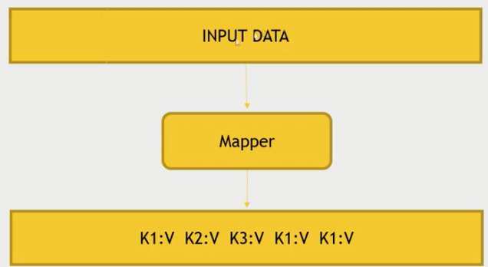
Map Abstraction
The Mapper converts raw source data into key/value pairs
Inputs a key/value pair
Key is a reference to the input value
Value is the data set on which to operate
Evaluation
Function defined by user
Applies to every value in value input
Might need to parse input
Produces a new list of key/value pairs
Can be different type from input pair

Slide 30
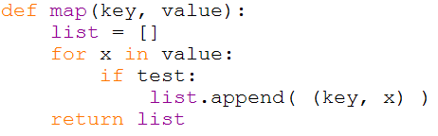
Map Example

Slide 31
Distributed Grep
Split data
grep
matches
Very
big
data
Split data
grep
matches
cat
All
matches
Split data
grep
matches
Split data
grep
matches

Slide 32
Distributed Word Count
Split data
count
count
Split data
count
count
Very
big
data
merged
count
Split data
count
count
merge
Split data
count
count

Slide 33
Map+Reduce
R
E
D
U
C
E
Very
big
data
M
A
P
Partitioning
Function
Result
Map:
Accepts input key/value pair
Emits intermediate key/value pair
Reduce :
Accepts intermediate key/value* pair
Emits output key/value pair

Slide 34
Reduce Abstraction
Starts with intermediate Key / Value pairs
Ends with finalized Key / Value pairs
Starting pairs are sorted by key
Iterator supplies the values for a given key to the Reduce function.
Typically a function that:
Starts with a large number of key/value pairs
One key/value for each word in all files being greped (including multiple entries for the same word)
Ends with very few key/value pairs
One key/value for each unique word across all the files with the number of instances summed into this entry
Broken up so a given worker works with input of the same key.

Slide 35
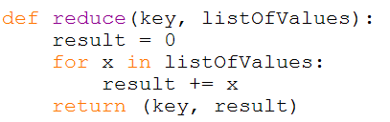
Reduce Example

Slide 36
How Map and Reduce Work Together
Map returns information
Reduces accepts information
Reduce applies a user defined function to reduce the amount of data

Slide 37
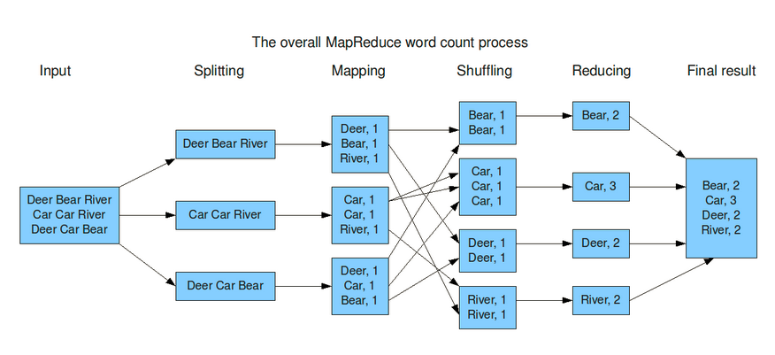
Mapreduce Example

Slide 38
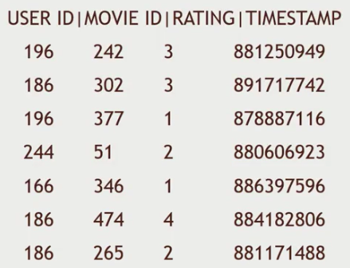

Map Reduce Example - 2
Dataset : MovieLens dataset
How many movies did each user rate in the MovieLens dataset?

Slide 39
Map Reduce Example - 2
Key will be the UserID
Values will be MovieID → aggregating

Slide 40
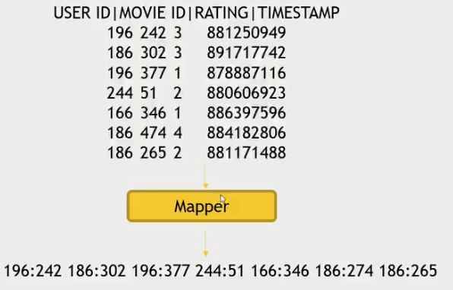
Map Reduce Example - 2
Map users to movies they watched:

Slide 41
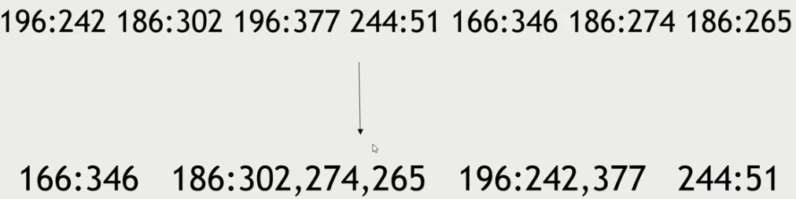
Map Reduce Example - 2
Map-Reduce sorts and groups the mapped data (“Shuffle and Sort”)

Slide 42
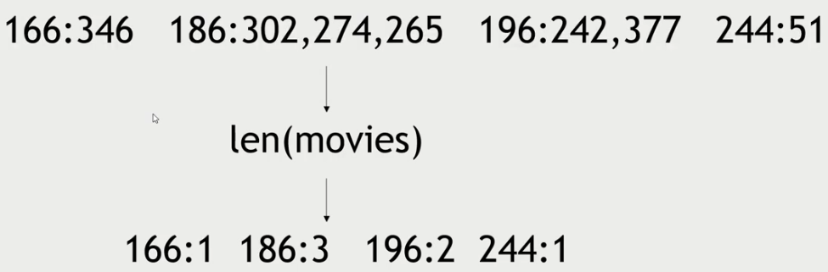
Map Reduce Example - 2
Reducer Process each key’s values

Slide 43
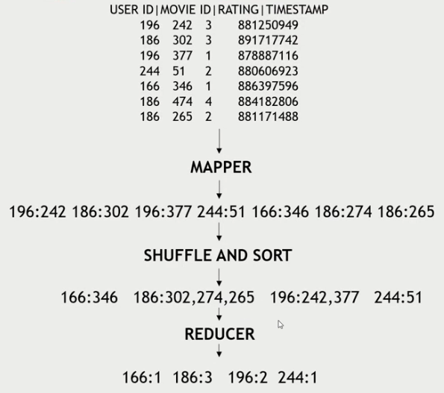
Map Reduce Example - 2
Final

Slide 44
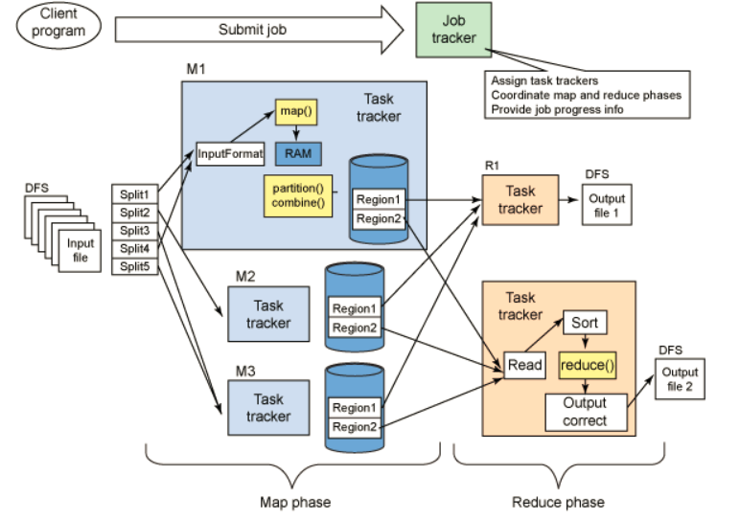
Mapreduce data flow

Slide 45


